Slide 1
Analysis of Puerto Rico’s Status of Electrical Infrastructure SURE C^2 Carmen Caiseda Daniel Barreiro Onix González Jorge Feliciano

Slide 2
Agenda
Introduction
3
Data Analysis
4
Python methodology
6
Challenges and solutions
9
References
10

Slide 3
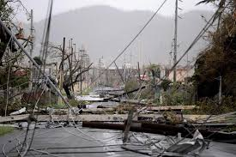
Introduction
3
On September 20, 2017, Puerto Rico got hit by the worst natural disaster in recent history
Island lost power for months
This blackout is believed to be the longest in U.S. history
These events highlight need for a more resilient system
We desired to quantify how catastrophic this collapse and look for potential solutions

Slide 4
Data Management
Data collection
Data cleaning
Data analysis

Slide 5
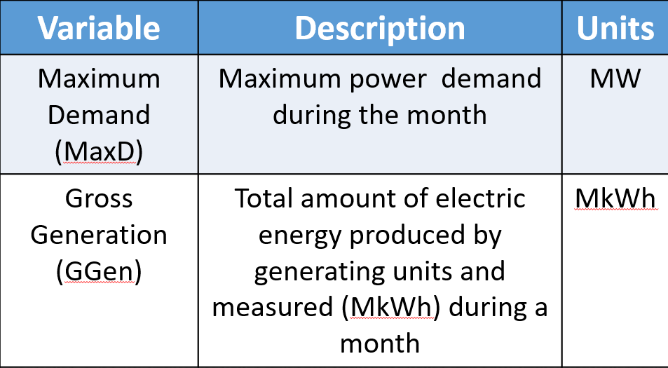
Data analysis - collection
We extracted Puerto Rico’s Electrical grid data from the PR Institute of Statistics; provided by the island’s current electrical distribution manager, LUMA Energy.

Slide 6
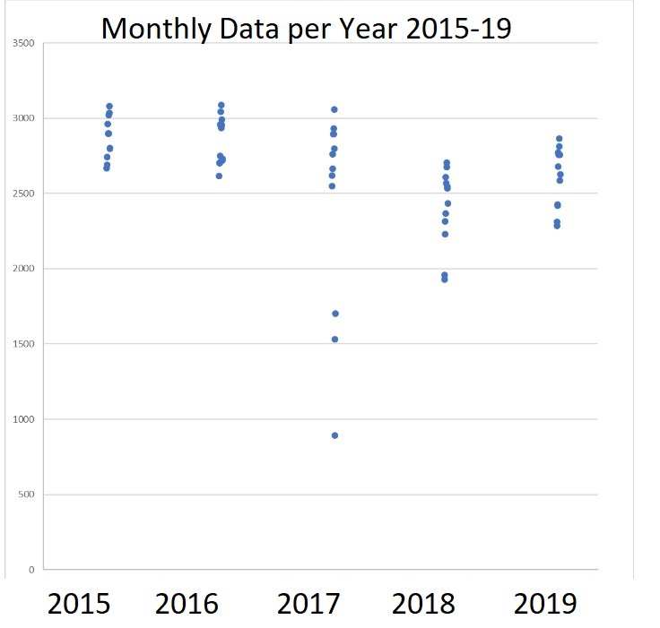
Excel Visualizations of Max Demand and Weather Data
Monthly Maximum Demand from Years 2015-2019

Slide 7
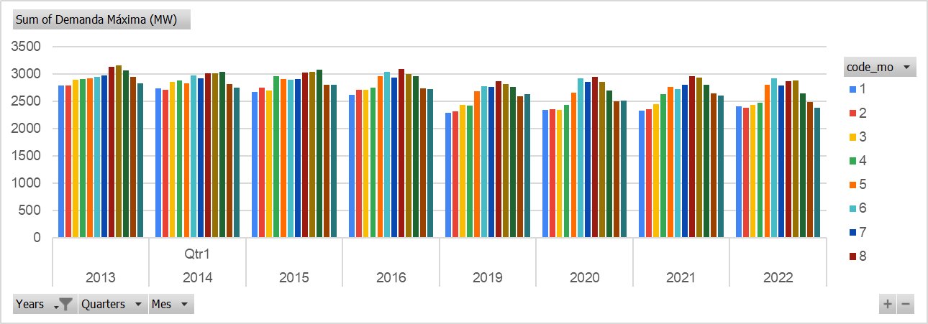
Excel Visualizations of Max Demand and Weather Data
Seasonality of Maximum Demand from Years 2013-2016, & 2019-2022

Slide 8
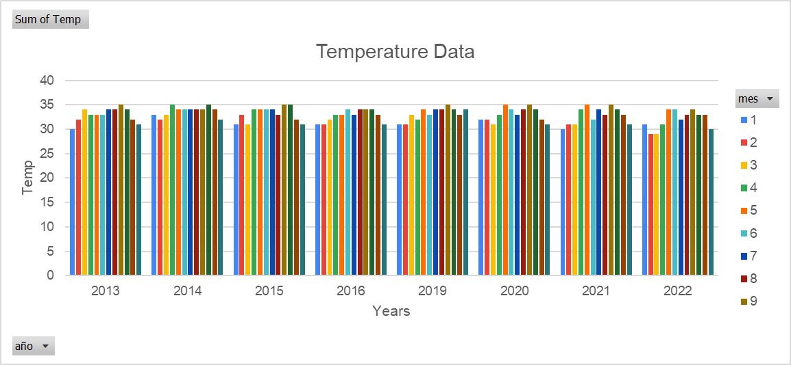
Excel Visualizations of Max Demand and Weather Data
Seasonality of Peak Temperature Weather Data of PR for Years 2013-2016, & 2019-2022.

Slide 9
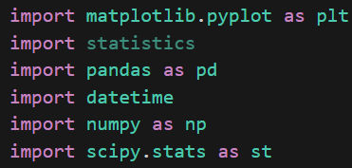
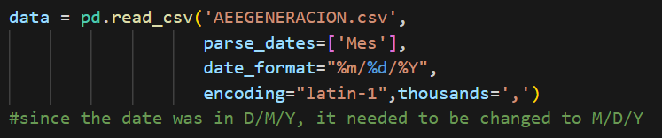
Python – Date formatting
A variety of Python libraries were imported to work with math, plotting and statistics
Code used to standardize the date in the U.S. format of m/d/y

Slide 10
Python – T test pre and post hurricane
Measure | Maximum D | Gross Generation
Mean ± t-critical* SE (Pre,Post) | 2940 ± 31.15 MW 2627 ± 50.12 MW | ± 23.11 MkWh ± 34.43 MkWh
Variance Pre Variance Post | 2.52 E4 4.36 E4 | 1.40 E4 2.07 E4
Observations (Pre,Pos) | (72 48) df = 82 | (72,48) df = 118
T-stat P-value – One-tail | 8.84 7.48 E-14 | 9.19 8.04 E-16
10

Slide 11
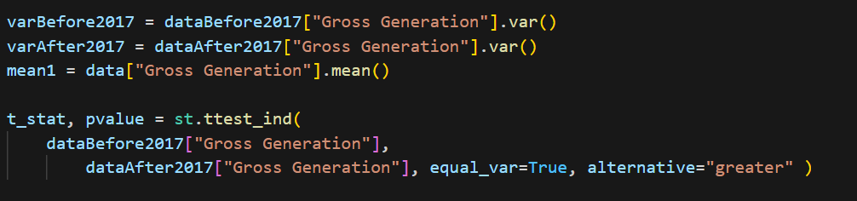
Python – T test pre and post hurricane
Means were calculated using the following code

Slide 12
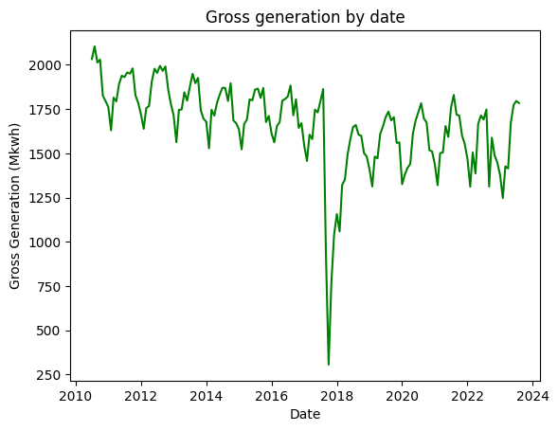
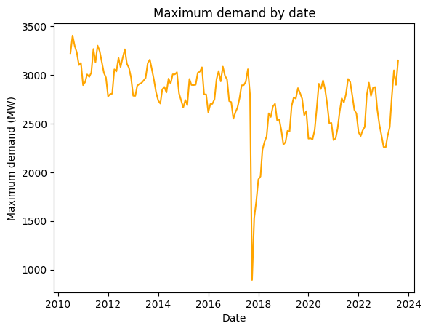
Python – plots of Gross generation and max demand

Slide 13
Potential challenges & solutions
Challenges:
Generation has failed to reach its pre-Maria peak
The biggest plant in the island still runs on old fossil fuel generators
Possible solutions:
Place capacitor banks to stabilize the grid by regulating power factor
Develop algorithms that can predict demand spikes and system irregularities
Replace old generators with renewable energy systems

Slide 14
References
Placeholder for references​
Generation, consumption, cost, income and customers of the Puerto Rico electrical system. (2023, March 13). https://www.indicadores.pr/dataset/generacion-consumo-costo-ingresos-y-clientes-del-sistema-electrico-de-puerto-rico/resource/8025f821-45c1-4c6a-b2f4-8d641cc03df1
Sandoval, R. (2019, 18 septiembre). HOJA DE RUTA DE RECURSOS ENERGÉTICOS DISTRIBUIDOS PARA PUERTO RICO. https://ieefa.org/sites/default/files/2023-01/Hoja-de-ruta-de-recursos-energeticos-distribuidos-para-Puerto-Rico-Fase-I-Final-11_2019.pdf

Slide 15
Thank you for your attention

